Slide 1
High-Resolution β-delayed γ-ray Study of the ¹¹⁰Tc→ ¹¹⁰Ru → ¹¹⁰Rh → ¹¹⁰Pd Isobaric Decay Chain
Shaheen Jazrawi
Department of Physics, University of Surrey
& Nuclear Metrology Group, National Physical Laboratory, UK
UNTF Workshop 2019, University of Surrey

Slide 2
Overview
Brief introduction to nuclear deformation
Explain interest in ¹¹⁰Ru
Experimental details
Resulting data
Summary and future work

Slide 3
Nuclear Deformation
Nuclei in excited states can be either prolate, oblate or triaxial
These can be characterised by the parameters – β and γ
US DOE Science Highlight (2017)
P. Moeller et al., At. Data Nucl. Data Tabl. 94 (2008)

Slide 4
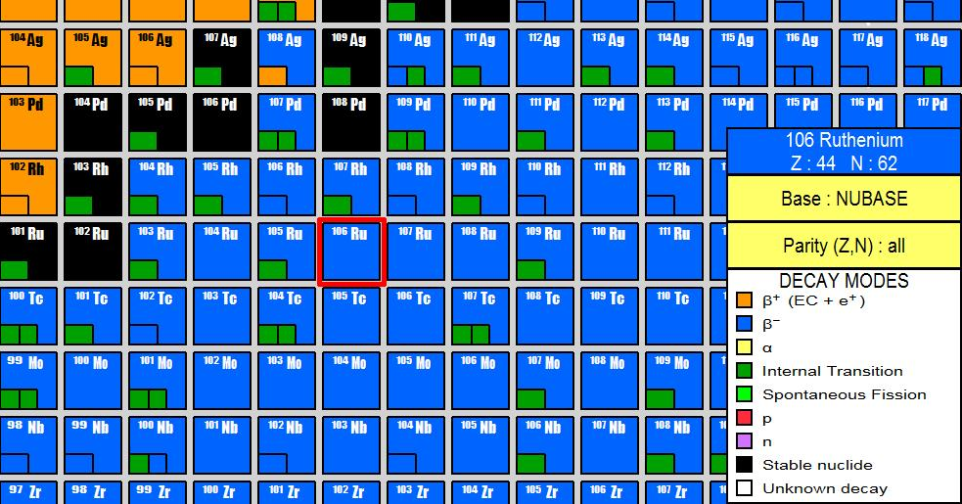
Triaxial Shapes in the A=110 Region
Deformation arises due to collective behaviour of nuclear states
Indications of triaxiality via the Triaxial Rotor Model:
-R₄₂ < 3.33 and ~ 2.7
-E(2₂⁺) < E(4₁⁺ )

Slide 5
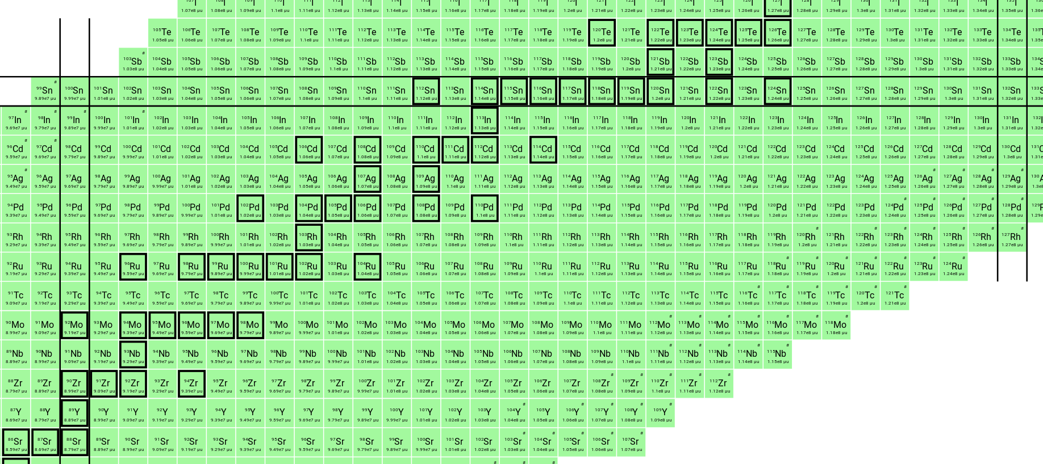
A=110 Nuclei
A = 110

Slide 6
A=110 Nuclei
¹¹⁰Tc (T_{1/2} = 0.91s) → ¹¹⁰Ru (T_{1/2} = 11.6s) → ¹¹⁰Rh (T_{1/2} = 3.35s) → ¹¹⁰Pd (stable)

Slide 7
Motivation and Aims
To find examples of triaxial deformation in ¹¹⁰Ru
Measure the reduced transition probability B(E2), mixing ratios (δ(M1/E2)and branching ratios from the low lying states to the I(π)=0⁺ ground state
Perform high-resolution gamma-ray coincidence analysis to identify previously unreported nuclear states to improve undersanding of decay population following beta-decay with a large Q_{β} - values

Slide 8
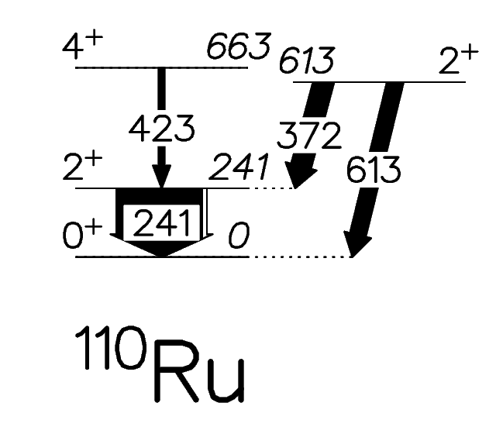
How Can We Measure Deformation?
Observe excited states in the nuclei of interest
Determine branching & mixing ratios, and B(E2) values
Input this information into the CoulEx analysis code GOSIA to determine deformation parameters

Slide 9
Mixing Ratios

Slide 10
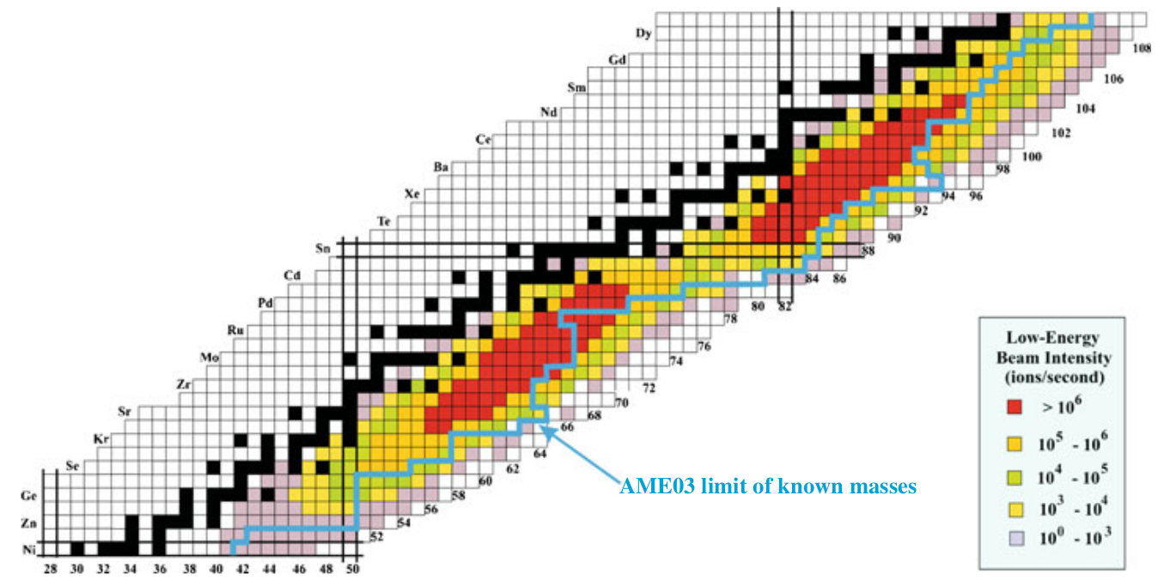
Caribu – ²⁵²Cf Fission Source
Fission fragments are passed through an isobar separator
Then sent through to ECR ion source for charge breeding
Ions then A/Q separated and injected into ATLAS

Slide 11
Experiment (Sept. 2018)
1) CoulEx: – 5 days of ¹¹⁰Ru on a 1.5mg/cm² ²⁰⁸Pb target
2) β- decay: – 2 days of ¹¹⁰Tc beam on a thick ¹⁹⁷Au target
RIB intensity: ~4000 A=110 particles per second in 1+ charge state
Data pre-sorted with a maximum coincidence timing condition of 1.42μs

Slide 12
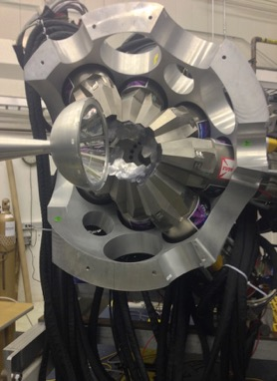
Gamma Ray Energy Tracking In Beam Array (GRETINA)
11 detector modules each consisting of 4 segmented HPGe detector
~1π solid angle; tracking and/or addback

Slide 13
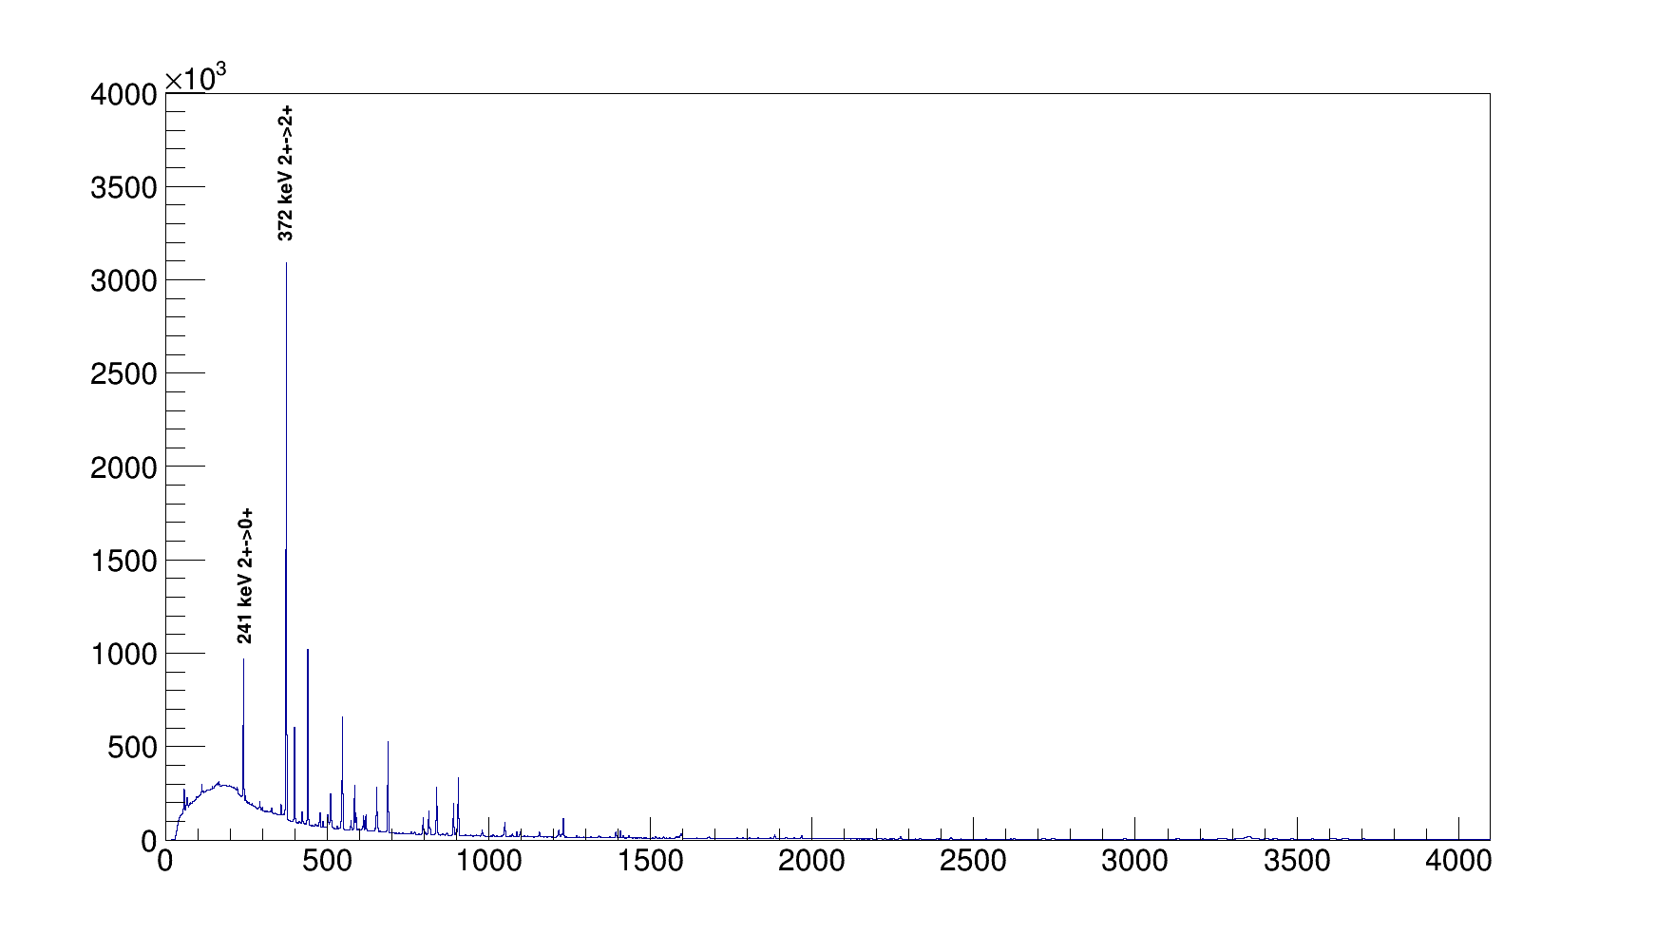
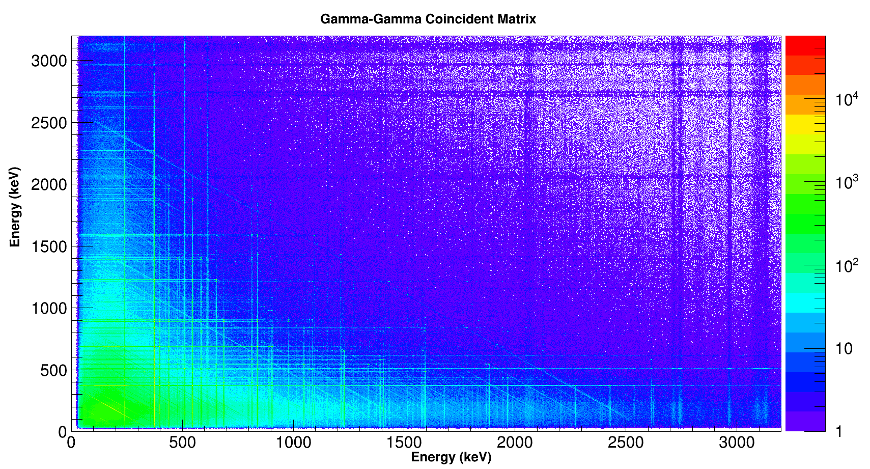
Results: Gamma-Gamma Coincidence for A=110 Nuclei

Slide 14
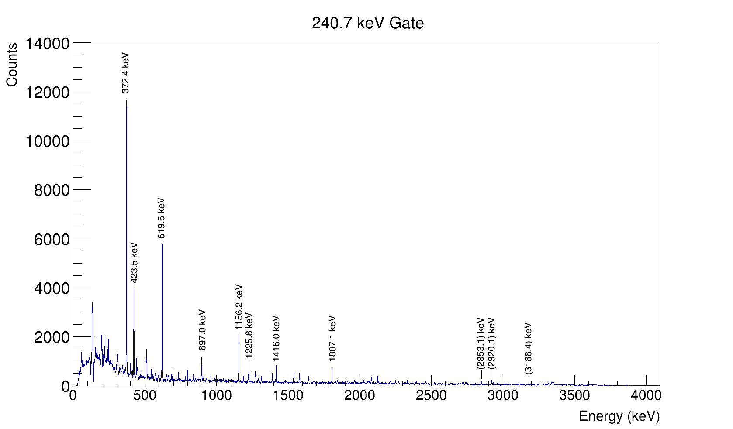
241keV Gate in 2+ → 0+ in 110Ru.

Slide 15
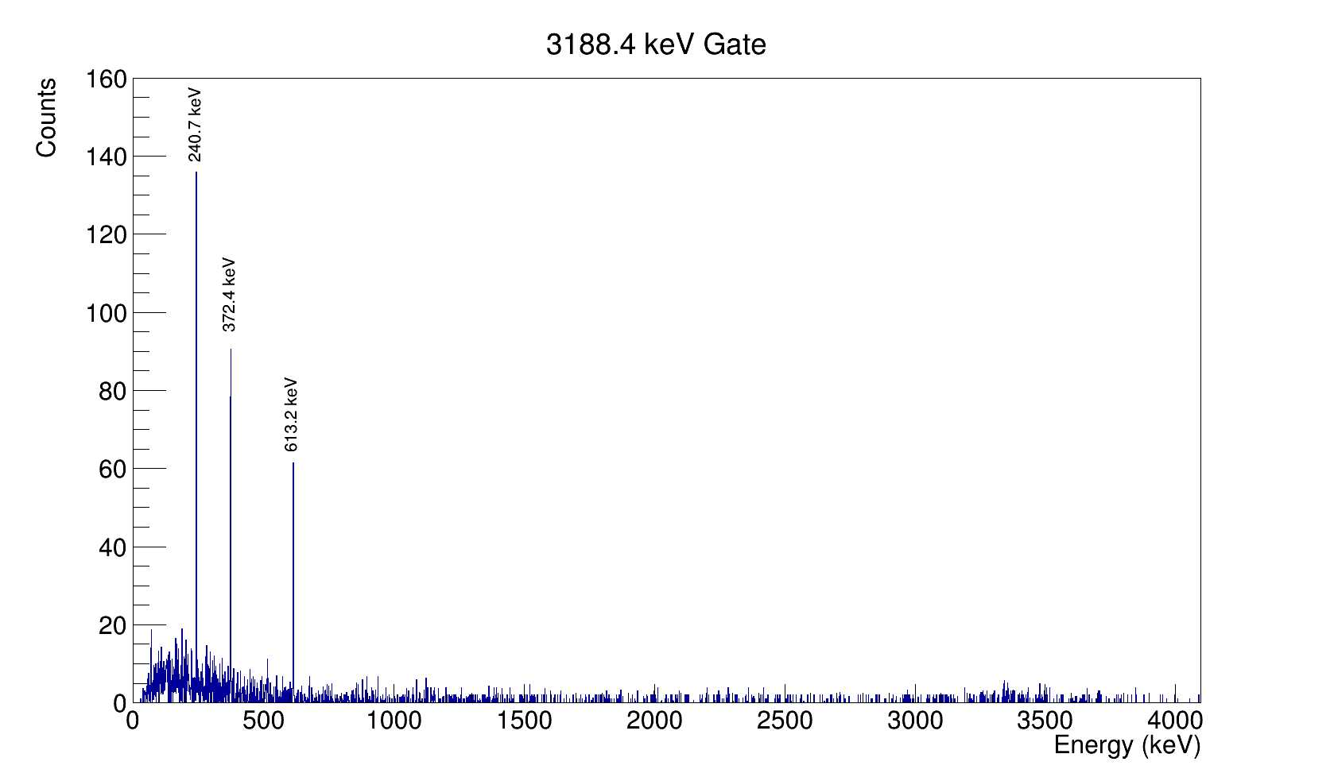
Identification of ‘new’ levels in 110Ru:
3188keV gate 110Ru, feeds directly to I(π)=2+ @613 keV

Slide 16
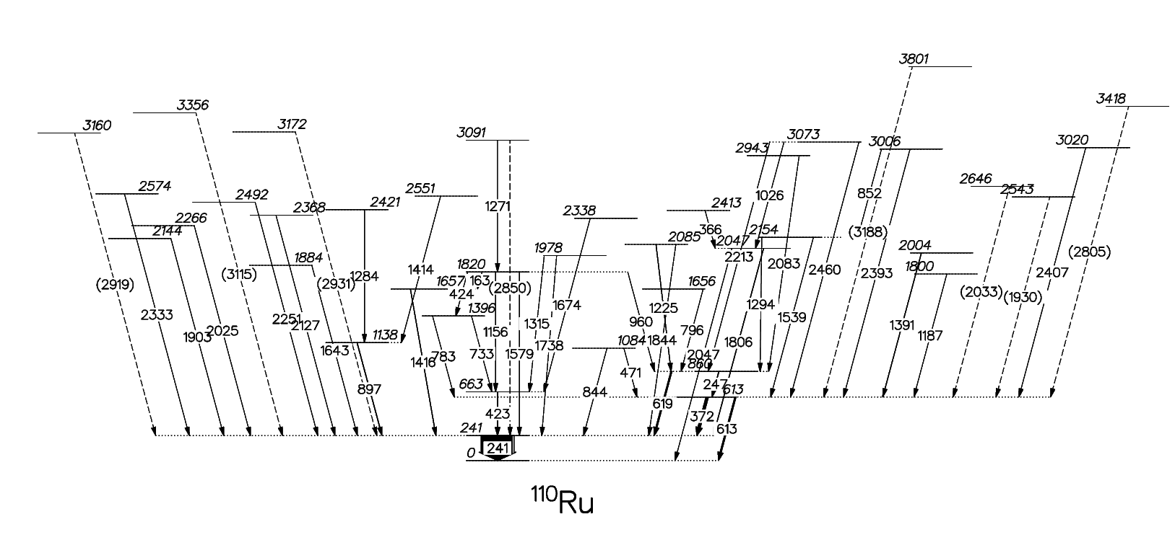
Updated Level Scheme for 110Tc → 110Ru

Slide 17
¹¹⁰Ru Angular Correlations (preliminary)
To be fitted using the following Legendre Polynomial -
W(θ) = A_{o} (1 + A₂P₂(cos(θ) + A₄P₄(cos(θ))

Slide 18
Summary
Analysis is ongoing
Spectrum to be analysed and fit for branching ratios
Angular correlations to be fitted and mixing ratios determined
Combination of beta decay and CoulEx data will be used to obtain the deformation parameters of ¹¹⁰Ru which describe the nuclear structure

Slide 19



Acknowledgements
Supervisors – Prof. Paddy Regan, Dr. Daniel Doherty
Surrey-Warsaw-ANL-Saclay-ORNL collaboration, especially Mitch Allmond for sort codes

Slide 20
Thank You For Listening

